Slide 1
Statistical Tables and Figures
Samuel D [Assistant Professor of Epidemiology & Biostatistics, PhD Fellow]

Slide 2
Statistical tables presentation

Slide 3
Introduction
A statistical table is an orderly and systematic presentation of numerical data in rows and columns. Rows (stubs) are horizontal and columns (captions) are vertical arrangements.
The use of tables for organizing data involves grouping the data into mutually exclusive categories of the variables and counting the number of occurrences (frequency) to each category.

Slide 4
Introduction cont…
These mutually exclusive categories, for qualitative variables, are naturally occurring groupings.
For example,
Sex (Male, Female),
Marital status (single, Married, divorced, widowed, etc.),
Blood group (A, B, AB, O),
Method of Delivery (Normal, forceps, Cesarean section, etc.), etc. are some qualitative variables with exclusive categories.

Slide 5
Construction of tables
Although there are no hard and fast rules to follow, the following general principles should be addressed in constructing tables.
Tables should be as simple as possible.
Tables should be self-explanatory.
If data are not original, their source should be given in a footnote.
Each row and column should be labelled.
Numerical entities of zero should be explicitly written rather than indicated by a dash. Dashed are reserved for missing or unobserved data.

Slide 6
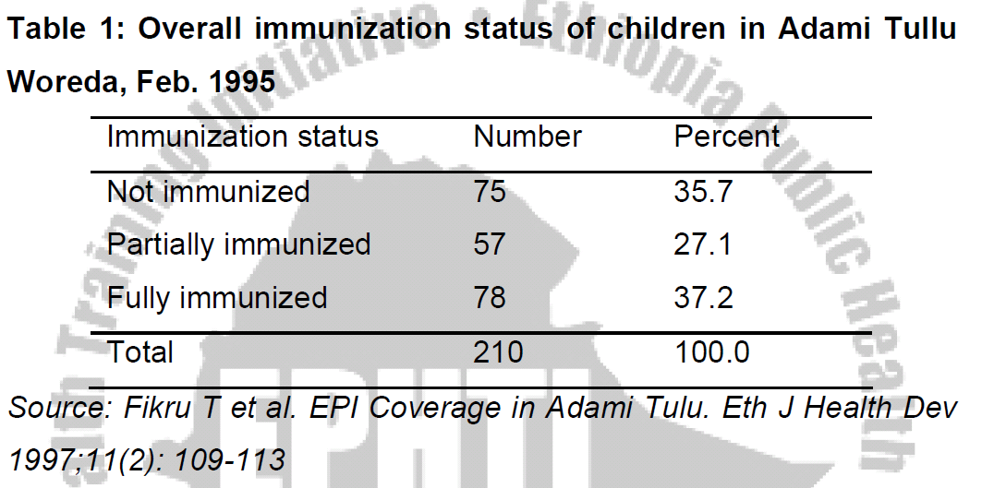
Simple or one-way table
The simple frequency table is used when the individual observations involve only to a single variable whereas the cross tabulation is used to obtain the frequency distribution of one variable by the subset of another variable.

Slide 7
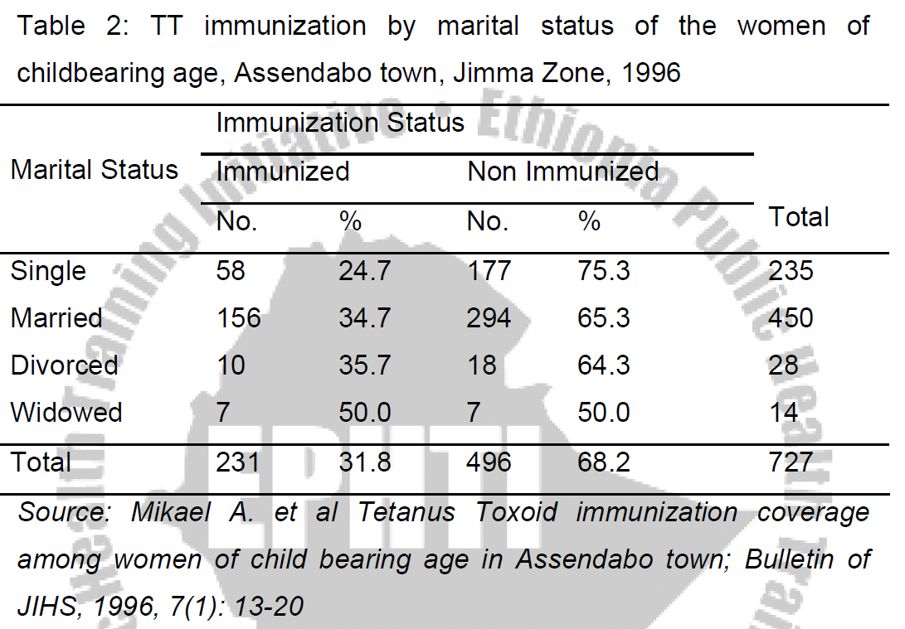
Two-way table
This table shows two characteristics and is formed when either the caption or the stub is divided into two or more parts.
In cross tabulated frequency distributions where there are row and column totals, the decision for the denominator is based on the variable of interest to be compared over the subset of the other variable.

Slide 8
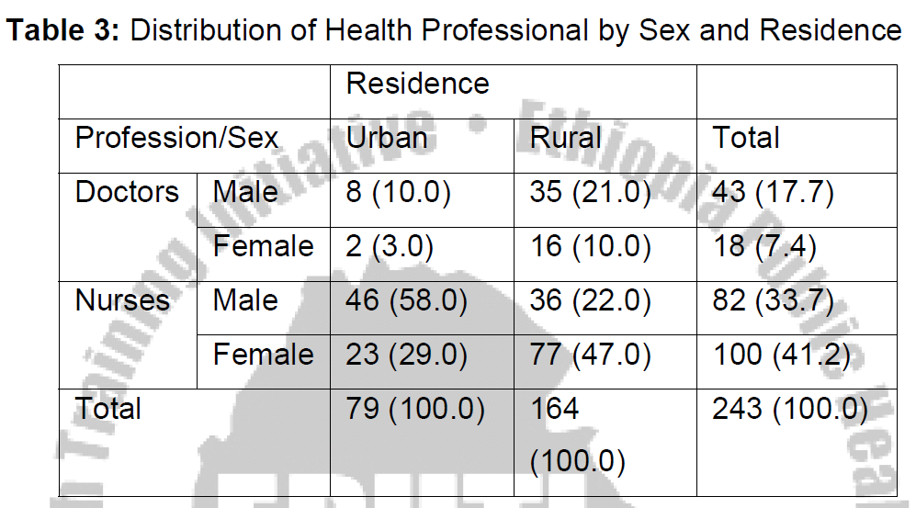
Higher Order Table
When it is desired to represent three or more characteristics in a single table.
Thus, if it is desired to represent the `Profession,' `sex' and `Residence,' of the study individuals, the table would take the form as shown in table 3 below and would be called higher order table.

Slide 9
Diagrammatic Representation of Data

Slide 10
Introduction
Appropriately drawn graph allows readers to obtain rapidly an overall grasp of the data presented.
The relationship between numbers of various magnitudes can usually be seen more quickly and easily from a graph than from a table.
Figures are not always interesting, and as their size and number increase they become confusing and uninteresting to such an extent that no one (unless he is specifically interested) would care to study them.

Slide 11
Importance of Diagrammatic Representation
They have greater attraction than mere figures. They give delight to the eye and add a spark of interest.
They help in deriving the required information in less time and without any mental strain.
They facilitate comparison.
They may reveal unsuspected patterns in a complex set of data and may suggest directions in which changes are occurring. This warns us to take an immediate action.
They have greater memorizing value than mere figures. This is so because the impression left by the diagram is of a lasting nature.

Slide 12
Limitations of Diagrammatic Representation
The technique of diagrammatic representation is made use only for purposes of comparison. It is not to be used when comparison is either not possible or is not necessary.
Diagrammatic representation is not an alternative to tabulation. It only strengthens the textual exposition of a subject, and cannot serve as a complete substitute for statistical data.
It can give only an approximate idea and as such where greater accuracy is needed diagrams will not be suitable.
They fail to bring to light small differences

Slide 13
Construction of graphs
The choice of the particular form among the different possibilities will depend on personal choices and/or the type of the data.
Bar charts and pie chart are commonly used for qualitative or quantitative discrete data.
Histograms, frequency polygons are used for quantitative continuous data.

Slide 14
There are, however, general rules that are commonly accepted about construction of graphs.
Every graph should be self-explanatory and as simple as possible.
Titles are usually placed below the graph and it should again question what ? Where? When? How classified?
Legends or keys should be used to differentiate variables if more than one is shown
The axes label should be placed to read from the left side and from the bottom.
The units in to which the scale is divided should be clearly indicated.
The numerical scale representing frequency must start at zero or a break in the line should be shown.

Slide 15
1. Bar Chart
Bar diagrams are used to represent and compare the frequency distribution of discrete variables and attributes or categorical series.
When we represent data using bar diagram, all the bars must have equal width and the distance between bars must be equal.

Slide 16
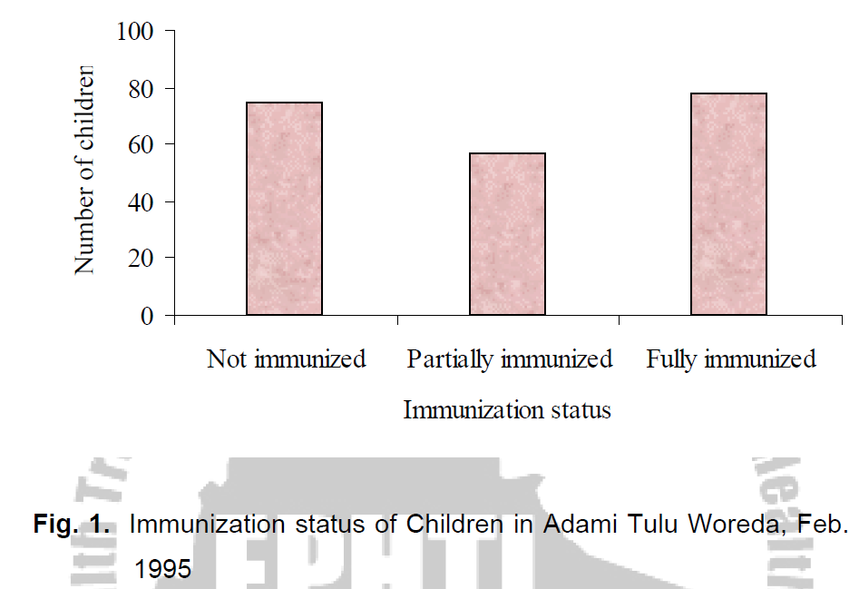
Simple bar chart:
It is a one-dimensional diagram in which the bar Represents the whole of the magnitude.
The height or length of each bar indicates the size (frequency) of the figure represented.

Slide 17
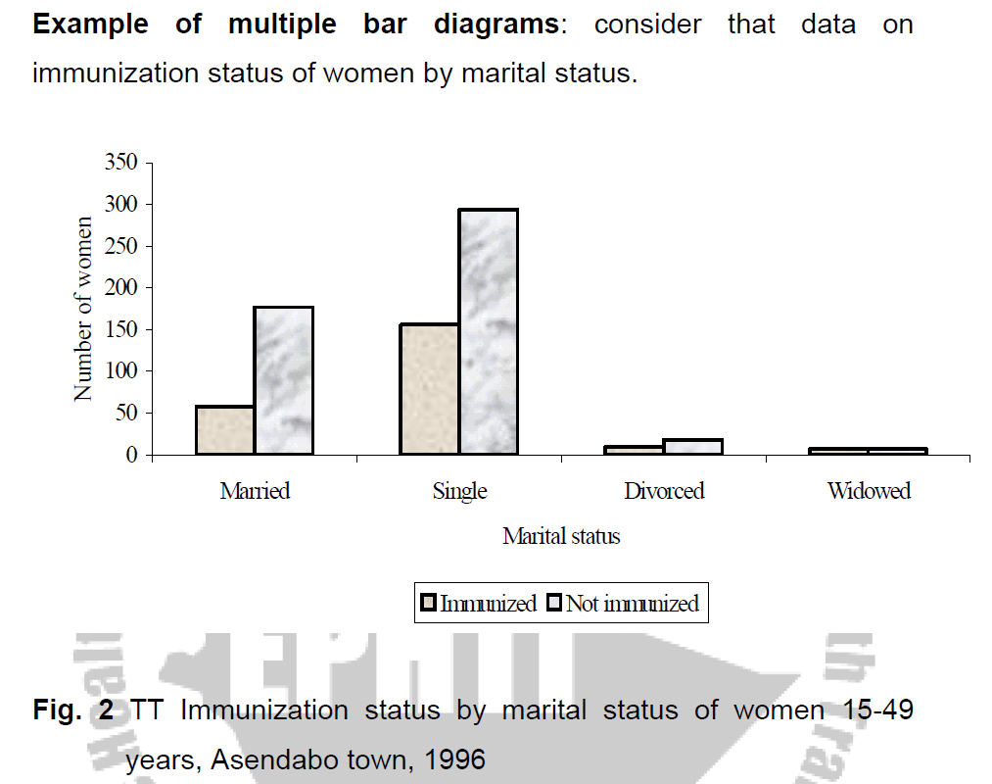
Bar Chart cont….
B. Multiple bar chart:
In this type of chart the component figures are shown as separate bars adjoining each other.
The height of each bar represents the actual value of the component figure.
It depicts distributional pattern of more than one variable

Slide 18
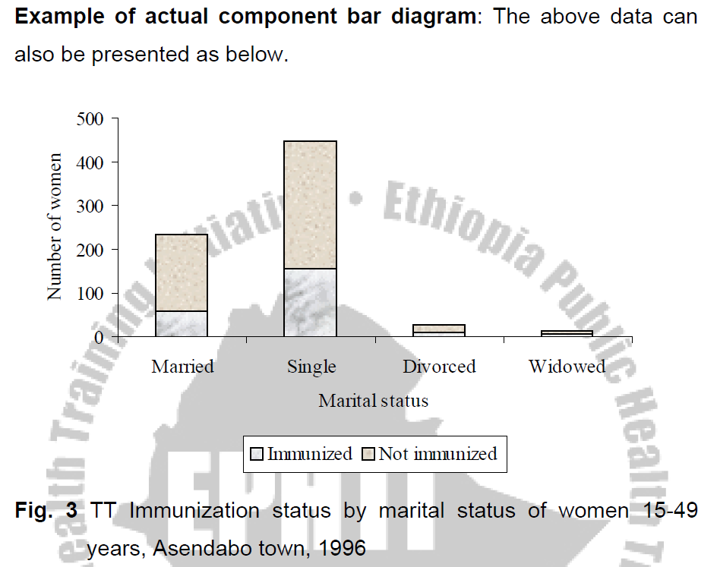
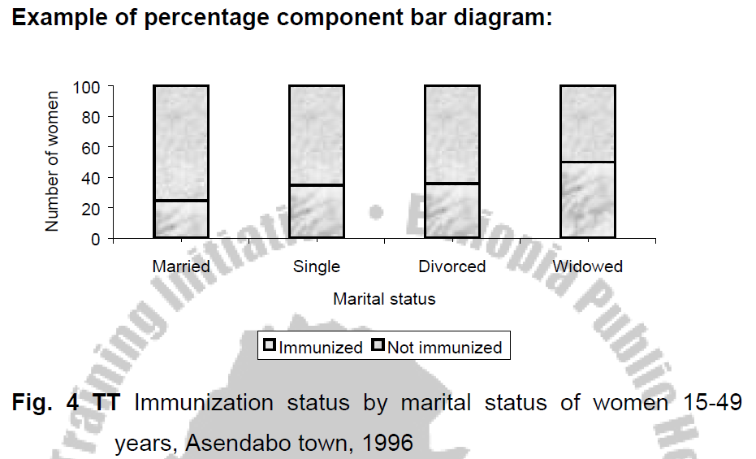
Bar Chart cont….
C. Component (or sub-divided) Bar Diagram:
Bars are sub-divided into component parts of the figure.
These sorts of diagrams are constructed when each total is built up from two or more component figures. They can be of two kind:
i) Actual Component Bar Diagram
ii) Percentage Component Bar Diagram

Slide 19
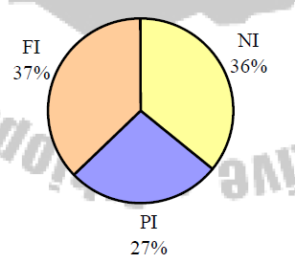
Pie-chart (qualitative or quantitative discrete data) It is a circle divided into sectors so that the areas of the sectors are proportional to the frequencies.
Fig. 5. Immunization status of children in Adami Tullu Woreda, Feb. 1995

Slide 20
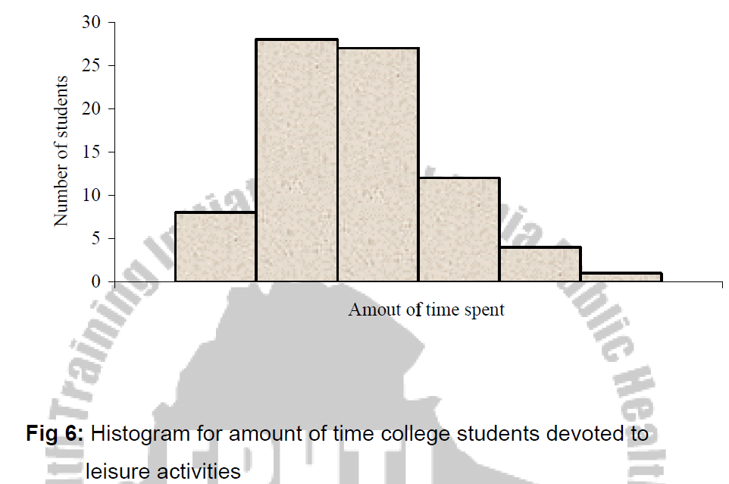
Histograms (quantitative continuous data)
A histogram is the graph of the frequency distribution of continuous measurement variables.

Slide 21
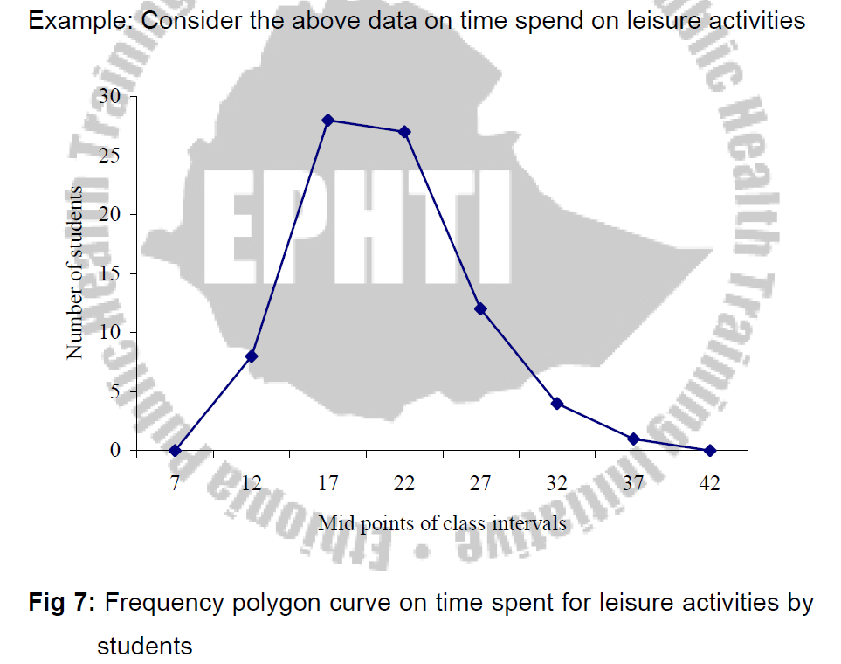
FREQUENCY POLYGON
If we join the midpoints of the tops of the adjacent rectangles of the histogram with line segments a frequency polygon is obtained.
Note that it is not essential to draw histogram in order to obtain frequency polygon.

Slide 22
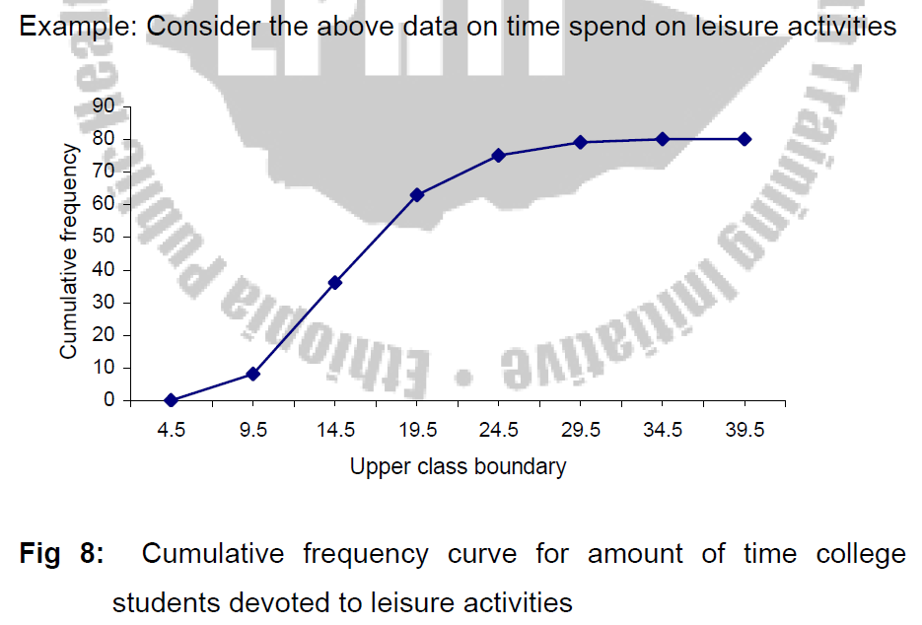
OGIVE OR CUMULATIVE FREQUENCY CURVE:
When the cumulative frequencies of a distribution are graphed the resulting curve is called Ogive Curve.

Slide 23
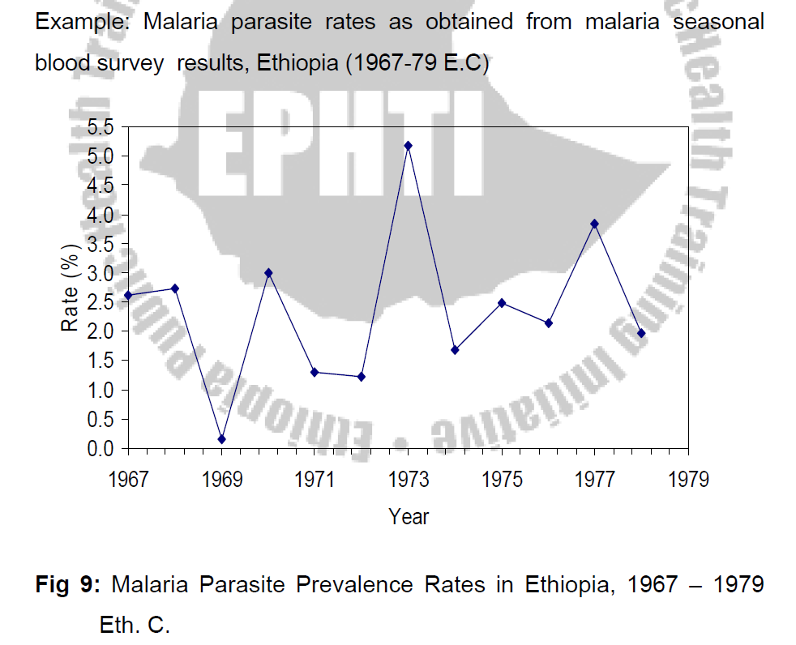
The line diagram
The line graph is especially useful for the study of some variables according to the passage of time.
The time, in weeks, months or years is marked along the horizontal axis; and the value of the quantity that is being studied is marked on the vertical axis.

Slide 24
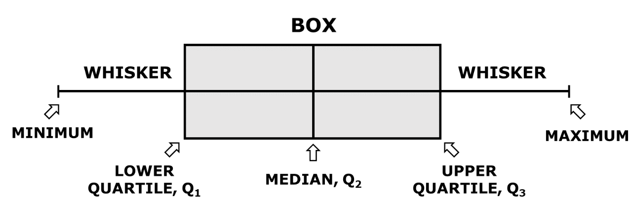
Box and Whisker plot (Box plot)
is a graphical representation of a dataset’s distribution, providing a summary of its central tendency and variability.
It contains
Median
Quartiles (Q1 & Q3)
IQR
Whiskers

Slide 25
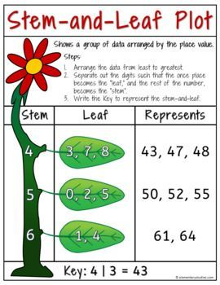
Steam and leaf plot
is a simple way to display data while retaining the original values.
Best for small to moderate-sized datasets.

Slide 26
Thank You!!

